Slide 1

Vocal Vision
Bringing Conversations to Life

Slide 2
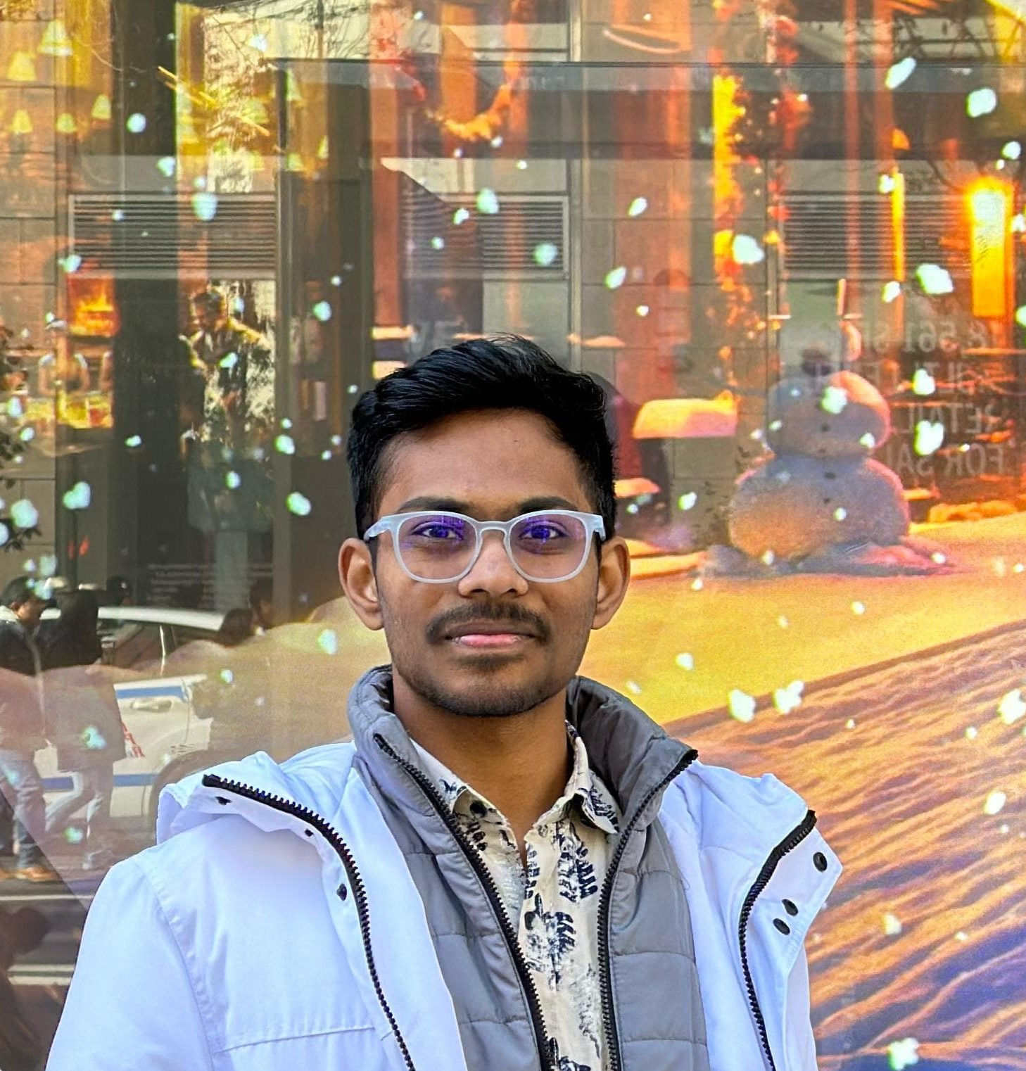

Team
Aaryan Yekkisetty – AI, Python Flask, MongoDB (Backend)
Hassan Zafar – Frontend, and MongoDB
Fun Fact #1:
We started with a team of 4 but went down to us 2

Slide 3
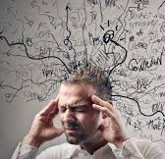
Problem Statement
Challenge: In today's information-rich world, people struggle to consume and retain vast amounts of data efficiently.
Limitation: Audio-only podcasts, like those generated by NotebookLM, lack visual engagement, which can limit understanding, especially for visual learners and individuals with hearing impairments.
Need: A solution to transform text into engaging multimedia content that is accessible and easy to digest.

Slide 4

Introducing Vocal Visions
A full-stack extension of NotebookLM that converts textual queries into engaging video podcasts with talking avatars.
By integrating advanced AI technologies such as speaker diarization and video generation, we enhance NotebookLM's capabilities, adding a visual dimension to information sharing.
Users input queries/audio file and upload images of the speakers, and our platform generates a personalized video podcast.

Slide 5


How we do it?
Query
Source scrounger
Sources
Podcast
Male speaker Image
Video Podcast
Vocal
Vision
Female speaker Image

Slide 6
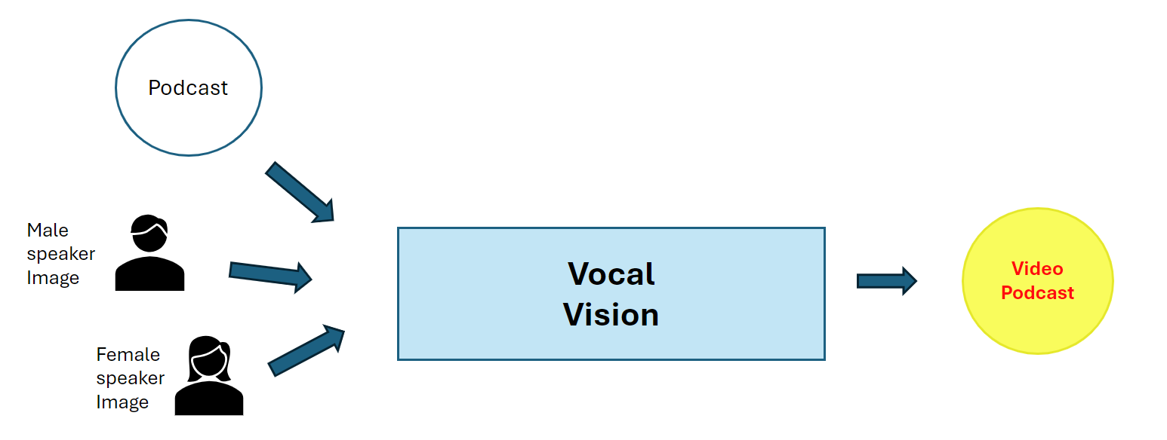
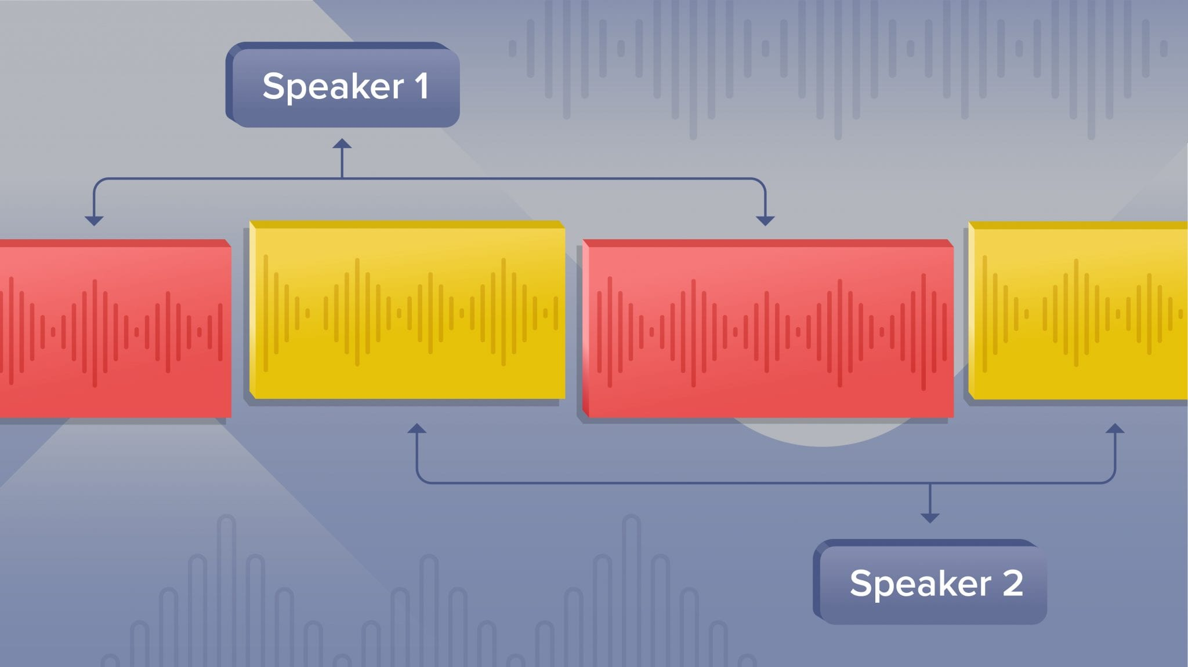
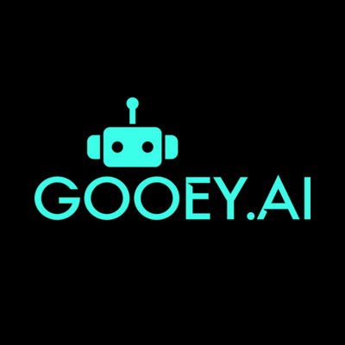
Vocal Vision
Speaker Diarization
(using Pyannote audio)
Audio
Podcast
Speaker Audio
Male speaker Image
Speaker Audio
Video Podcast
Female speaker Image
Lipsync Video Gen

Slide 7
DEMO!

Slide 8
Use Cases:
Educational Content
Corporate Training
Marketing and Advertising
Accessibility
Provides content in both audio and visual formats.
Supports individuals with different learning preferences and needs.
Multilingual Support (Future Integration):
Potential to generate content in various languages.
Broadens reach to a global audience.

Slide 9
General Track: Media Sponsor Track: Google MLH Track: 1. MongoDB 2. Fidelity 3. GoDaddy

Slide 10
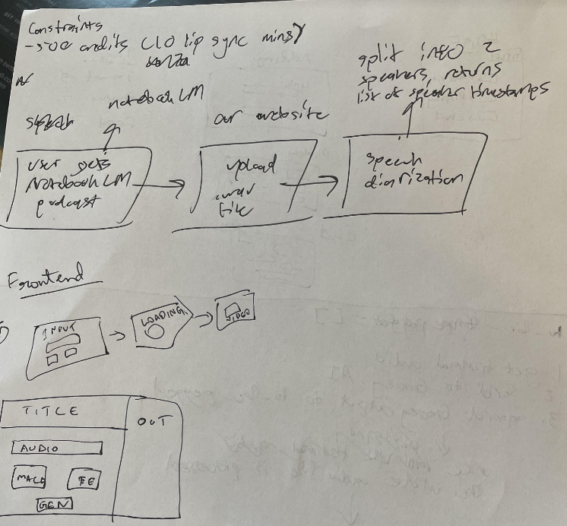
Future Iterations – Timeline(Agile)
Next 3 Months: User interface redesign and multi-language support.
Next 6 Months: Avatar customization and performance enhancements.
Next 12 Months: Platform integrations and new features rollout.

Slide 11
Thank You!

